Slide 1
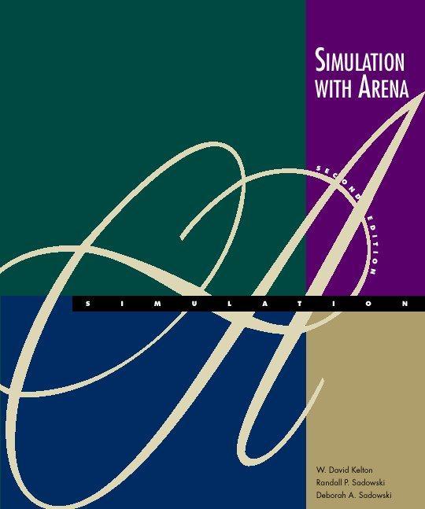
Fundamental Simulation Concepts
Chapter 2
Simulation with Arena
Chapter 2 – Fundamental Simulation Concepts
Slide <number> of 46

Slide 2
What We’ll Do ...
Underlying ideas, methods, and issues in simulation
Software-independent (setting up for Arena)
Centered around an example of a simple processing system
  Decompose the problem
  Terminology
  Simulation by hand
  Some basic statistical issues
  Overview of a simulation study
Simulation with Arena
Chapter 2 – Fundamental Simulation Concepts
Slide <number> of 46

Slide 3
The System:
A Simple Processing System
Machine
(Server)
Arriving
Blank Parts
Departing
Finished Parts
7
6
5
4
Queue (FIFO)
Part in Service
General intent:
  Estimate expected production
  Waiting time in queue, queue length, proportion of time machine is busy
Time units
  Can use different units in different places … must declare
  Be careful to check the units when specifying inputs
  Declare base time units for internal calculations, outputs
  Be reasonable (interpretation, roundoff error)
Simulation with Arena
Chapter 2 – Fundamental Simulation Concepts
Slide <number> of 46

Slide 4
Model Specifics
Initially (time 0) empty and idle
Base time units: minutes
Input data (assume given for now …), in minutes:
Part Number Arrival Time Interarrival Time Service Time
1 0.00 1.73 2.90
2 1.73 1.35 1.76
3 3.08 0.71 3.39
4 3.79 0.62 4.52
5 4.41 14.28 4.46
6 18.69 0.70 4.36
7 19.39 15.52 2.07
8 34.91 3.15 3.36
9 38.06 1.76 2.37
10 39.82 1.00 5.38
11 40.82 . .
. . . .
. . . .
Stop when 20 minutes of (simulated) time have passed
Simulation with Arena
Chapter 2 – Fundamental Simulation Concepts
Slide <number> of 46

Slide 5
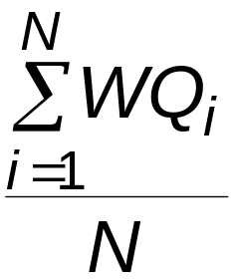
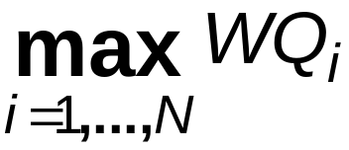
Goals of the Study:
Output Performance Measures
Total production of parts over the run (P)
Average waiting time of parts in queue:
Maximum waiting time of parts in queue:
N = no. of parts completing queue wait
WQ_{i} = waiting time in queue of ith part
Know: WQ₁ = 0 (why?)
N > 1 (why?)
Simulation with Arena
Chapter 2 – Fundamental Simulation Concepts
Slide <number> of 46

Slide 6
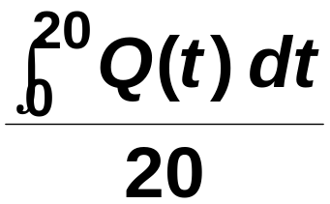
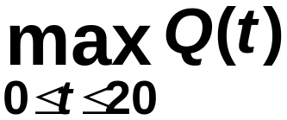
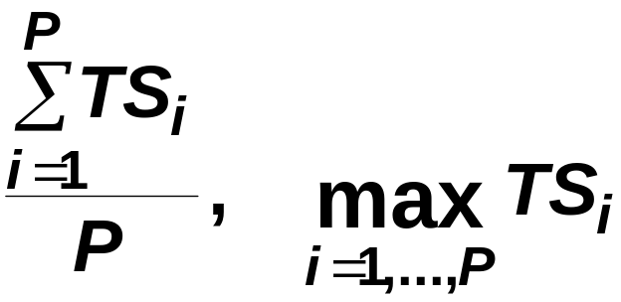
Goals of the Study:
Output Performance Measures (cont’d.)
Time-average number of parts in queue:
Maximum number of parts in queue:
Average and maximum total time in system of parts (a.k.a. cycle time):
Q(t) = number of parts in queue
at time t
TS_{i} = time in system of part i
Simulation with Arena
Chapter 2 – Fundamental Simulation Concepts
Slide <number> of 46

Slide 7
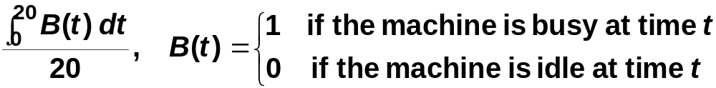
Goals of the Study:
Output Performance Measures (cont’d.)
Utilization of the machine (proportion of time busy)
Many others possible (information overload?)
Simulation with Arena
Chapter 2 – Fundamental Simulation Concepts
Slide <number> of 46

Slide 8
Analysis Options
Educated guessing
  Average interarrival time = 4.08 minutes
  Average service time = 3.46 minutes
  So (on average) parts are being processed faster than they arrive
    System has a chance of operating in a stable way in the long run, i.e., might not “explode”
    If all interarrivals and service times were exactly at their mean, there would never be a queue
    But the data clearly exhibit variability, so a queue could form
  If we’d had average interarrival < average service time, and this persisted, then queue would explode
  Truth — between these extremes
  Guessing has its limits …
Simulation with Arena
Chapter 2 – Fundamental Simulation Concepts
Slide <number> of 46

Slide 9
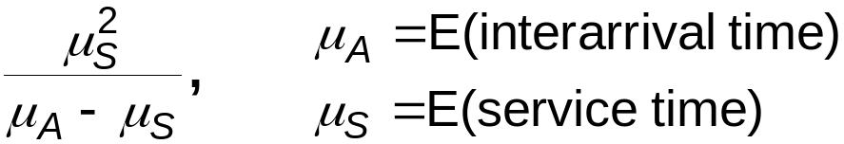
Analysis Options (cont’d.)
Queueing theory
  Requires additional assumptions about the model
  Popular, simple model: M/M/1 queue
    Interarrival times ~ exponential
    Service times ~ exponential, indep. of interarrivals
    Must have E(service) < E(interarrival)
    Steady-state (long-run, forever)
    Exact analytic results; e.g., average waiting time in queue is
  Problems: validity, estimating means, time frame
  Often useful as first-cut approximation
Simulation with Arena
Chapter 2 – Fundamental Simulation Concepts
Slide <number> of 46

Slide 10
Mechanistic Simulation
Individual operations (arrivals, service times) will occur exactly as in reality
Movements, changes occur at the right “time,” in the right order
Different pieces interact
Install “observers” to get output performance measures
Concrete, “brute-force” analysis approach
Nothing mysterious or subtle
  But a lot of details, bookkeeping
  Simulation software keeps track of things for you
Simulation with Arena
Chapter 2 – Fundamental Simulation Concepts
Slide <number> of 46

Slide 11
Pieces of a Simulation Model
Entities
  “Players” that move around, change status, affect and are affected by other entities
  Dynamic objects — get created, move around, leave (maybe)
  Usually represent “real” things
    Our model: entities are the parts
  Can have “fake” entities for modeling “tricks”
    Breakdown demon, break angel
  Usually have multiple realizations floating around
  Can have different types of entities concurrently
  Usually, identifying the types of entities is the first thing to do in building a model
Simulation with Arena
Chapter 2 – Fundamental Simulation Concepts
Slide <number> of 46

Slide 12
Pieces of a Simulation Model (cont’d.)
Attributes
  Characteristic of all entities: describe, differentiate
  All entities have same attribute “slots” but different values for different entities, for example:
    Time of arrival
    Due date
    Priority
    Color
  Attribute value tied to a specific entity
  Like “local” (to entities) variables
  Some automatic in Arena, some you define
Simulation with Arena
Chapter 2 – Fundamental Simulation Concepts
Slide <number> of 46

Slide 13
Pieces of a Simulation Model (cont’d.)
(Global) Variables
  Reflects a characteristic of the whole model, not of specific entities
  Used for many different kinds of things
    Travel time between all station pairs
    Number of parts in system
    Simulation clock (built-in Arena variable)
  Name, value of which there’s only one copy for the whole model
  Not tied to entities
  Entities can access, change variables
  Writing on the wall
  Some built-in by Arena, you can define others
Simulation with Arena
Chapter 2 – Fundamental Simulation Concepts
Slide <number> of 46

Slide 14
Pieces of a Simulation Model (cont’d.)
Resources
  What entities compete for
    People
    Equipment
    Space
  Entity seizes a resource, uses it, releases it
  Think of a resource being assigned to an entity, rather than an entity “belonging to” a resource
  “A” resource can have several units of capacity
    Seats at a table in a restaurant
    Identical ticketing agents at an airline counter
  Number of units of resource can be changed during the simulation
Simulation with Arena
Chapter 2 – Fundamental Simulation Concepts
Slide <number> of 46

Slide 15
Pieces of a Simulation Model (cont’d.)
Queues
  Place for entities to wait when they can’t move on (maybe since the resource they want to seize is not available)
  Have names, often tied to a corresponding resource
  Can have a finite capacity to model limited space — have to model what to do if an entity shows up to a queue that’s already full
  Usually watch the length of a queue, waiting time in it
Simulation with Arena
Chapter 2 – Fundamental Simulation Concepts
Slide <number> of 46

Slide 16
Pieces of a Simulation Model (cont’d.)
Statistical accumulators
  Variables that “watch” what’s happening
  Depend on output performance measures desired
  “Passive” in model — don’t participate, just watch
  Many are automatic in Arena, but some you may have to set up and maintain during the simulation
  At end of simulation, used to compute final output performance measures
Simulation with Arena
Chapter 2 – Fundamental Simulation Concepts
Slide <number> of 46

Slide 17
Pieces of a Simulation Model (cont’d.)
Statistical accumulators for the simple processing system
  Number of parts produced so far
  Total of the waiting times spent in queue so far
  No. of parts that have gone through the queue
  Max time in queue we’ve seen so far
  Total of times spent in system
  Max time in system we’ve seen so far
  Area so far under queue-length curve Q(t)
  Max of Q(t) so far
  Area so far under server-busy curve B(t)
Simulation with Arena
Chapter 2 – Fundamental Simulation Concepts
Slide <number> of 46

Slide 18
Simulation Dynamics:
The Event-Scheduling “World View”
Identify characteristic events
Decide on logic for each type of event to
  Effect state changes for each event type
  Observe statistics
  Update times of future events (maybe of this type, other types)
Keep a simulation clock, future event calendar
Jump from one event to the next, process, observe statistics, update event calendar
Must specify an appropriate stopping rule
Usually done with general-purpose programming language (C, FORTRAN, etc.)
Simulation with Arena
Chapter 2 – Fundamental Simulation Concepts
Slide <number> of 46

Slide 19
Events for the
Simple Processing System
Arrival of a new part to the system
  Update time-persistent statistical accumulators (from last event to now)
    Area under Q(t)
    Max of Q(t)
    Area under B(t)
  “Mark” arriving part with current time (use later)
  If machine is idle:
    Start processing (schedule departure), Make machine busy, Tally waiting time in queue (0)
  Else (machine is busy):
    Put part at end of queue, increase queue-length variable
  Schedule the next arrival event
Simulation with Arena
Chapter 2 – Fundamental Simulation Concepts
Slide <number> of 46

Slide 20
Events for the
Simple Processing System (cont’d.)
Departure (when a service is completed)
  Increment number-produced stat accumulator
  Compute & tally time in system (now - time of arrival)
  Update time-persistent statistics (as in arrival event)
  If queue is non-empty:
    Take first part out of queue, compute & tally its waiting time in queue, begin service (schedule departure event)
  Else (queue is empty):
    Make the machine idle (Note: there will be no departure event scheduled on the future events calendar, which is as desired)
Simulation with Arena
Chapter 2 – Fundamental Simulation Concepts
Slide <number> of 46

Slide 21
Events for the
Simple Processing System (cont’d.)
The End
  Update time-persistent statistics (to end of the simulation)
  Compute final output performance measures using current (= final) values of statistical accumulators
After each event, the event calendar’s top record is removed to see what time it is, what to do
Also must initialize everything
Simulation with Arena
Chapter 2 – Fundamental Simulation Concepts
Slide <number> of 46

Slide 22
Some Additional Specifics for the
Simple Processing System
Simulation clock variable (internal in Arena)
Event calendar: List of event records:
  [Entity No., Event Time, Event Type]
  Keep ranked in increasing order on Event Time
  Next event always in top record
  Initially, schedule first Arrival, The End (Dep.?)
State variables: describe current status
  Server status B(t) = 1 for busy, 0 for idle
  Number of customers in queue Q(t)
  Times of arrival of each customer now in queue (a list of random length)
Simulation with Arena
Chapter 2 – Fundamental Simulation Concepts
Slide <number> of 46

Slide 23
Simulation by Hand
Manually track state variables, statistical accumulators
Use “given” interarrival, service times
Keep track of event calendar
“Lurch” clock from one event to the next
Will omit times in system, “max” computations here (see text for complete details)
Simulation with Arena
Chapter 2 – Fundamental Simulation Concepts
Slide <number> of 46

Slide 24
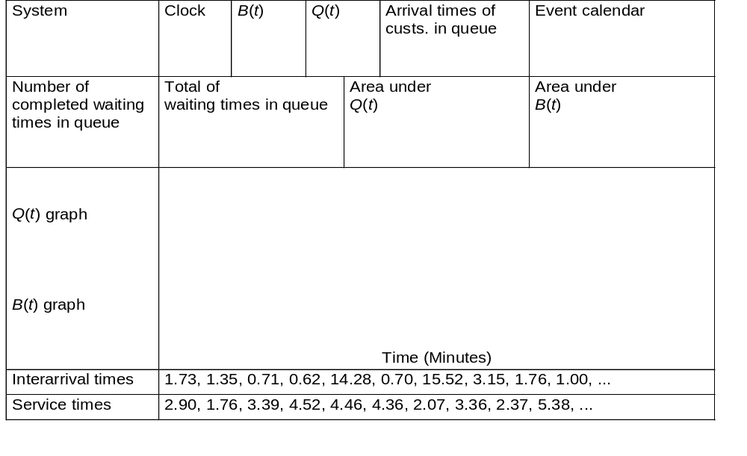
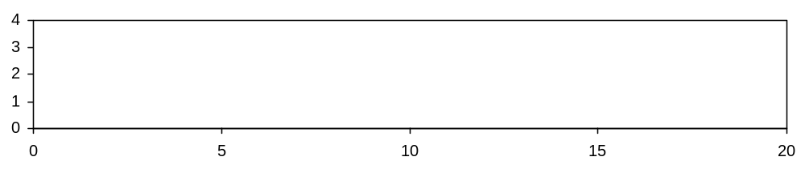
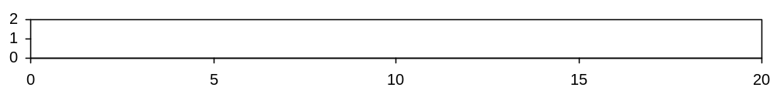
Simulation by Hand:
Setup
Simulation with Arena
Chapter 2 – Fundamental Simulation Concepts
Slide <number> of 46

Slide 25
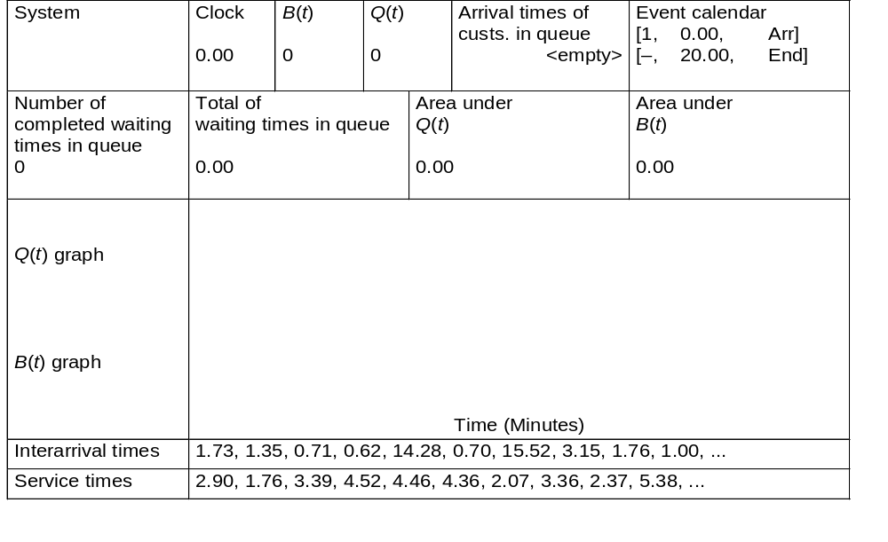
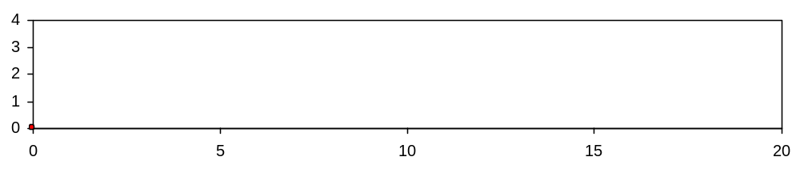
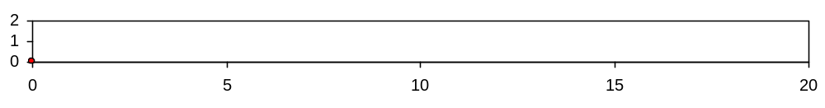
Simulation by Hand: t = 0.00, Initialize
Simulation with Arena
Chapter 2 – Fundamental Simulation Concepts
Slide <number> of 46

Slide 26
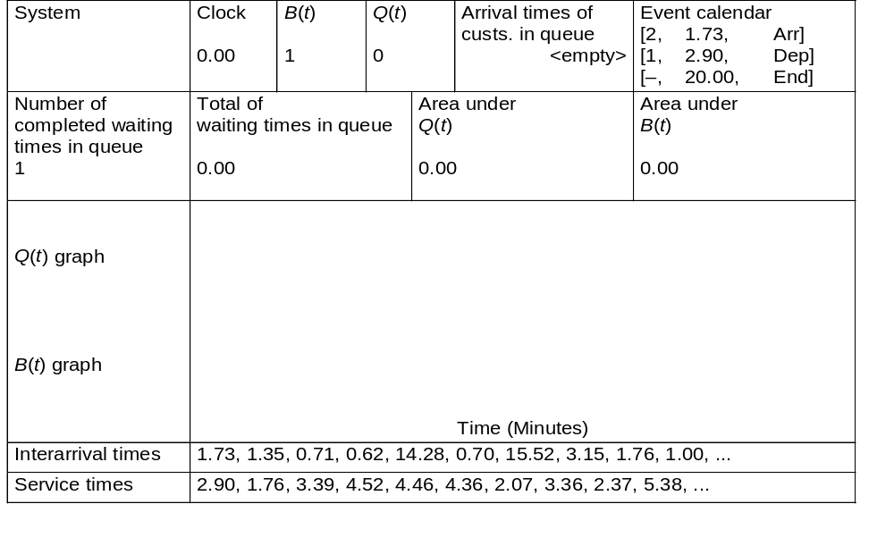

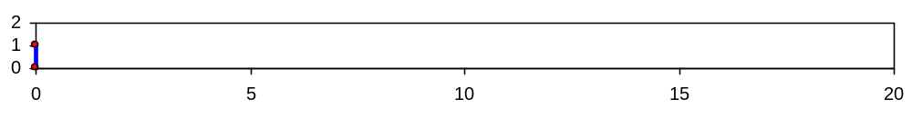
Simulation by Hand: t = 0.00, Arrival of Part 1
1
Simulation with Arena
Chapter 2 – Fundamental Simulation Concepts
Slide <number> of 46

Slide 27
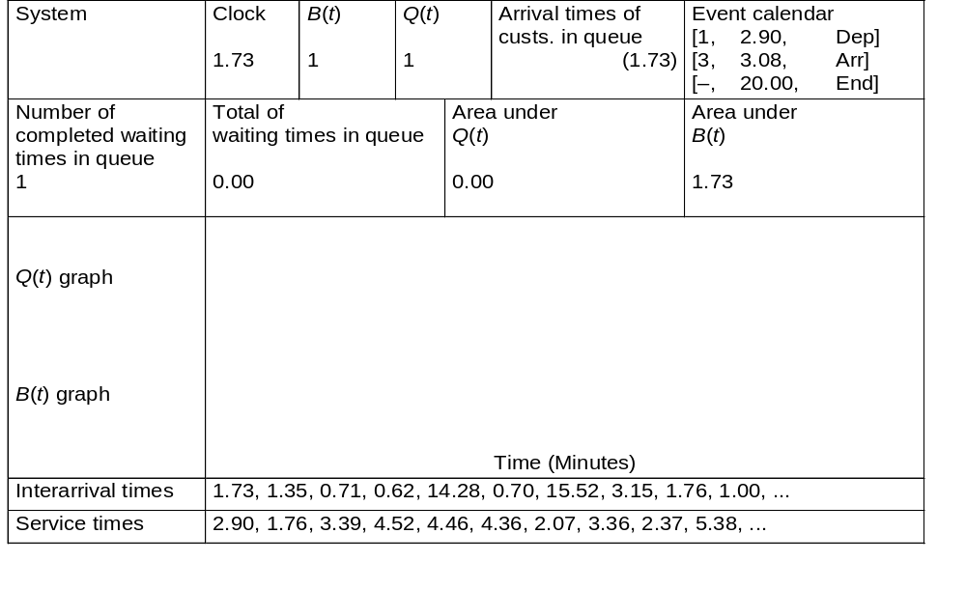
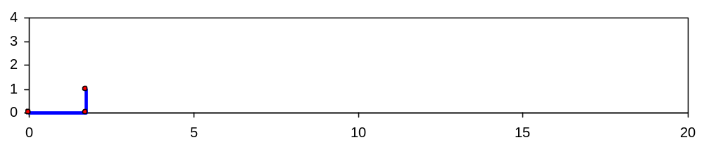
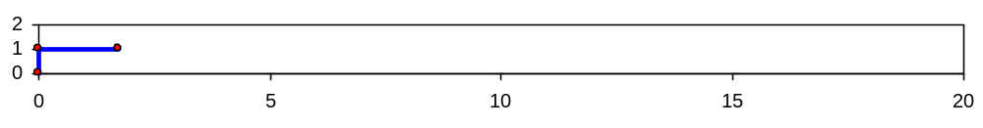
Simulation by Hand: t = 1.73, Arrival of Part 2
2
1
Simulation with Arena
Chapter 2 – Fundamental Simulation Concepts
Slide <number> of 46

Slide 28

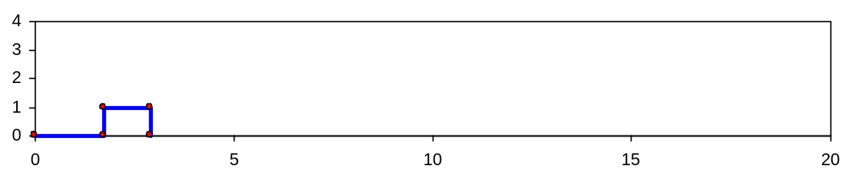
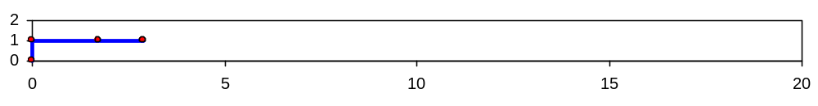
Simulation by Hand: t = 2.90, Departure of Part 1
2
Simulation with Arena
Chapter 2 – Fundamental Simulation Concepts
Slide <number> of 46

Slide 29
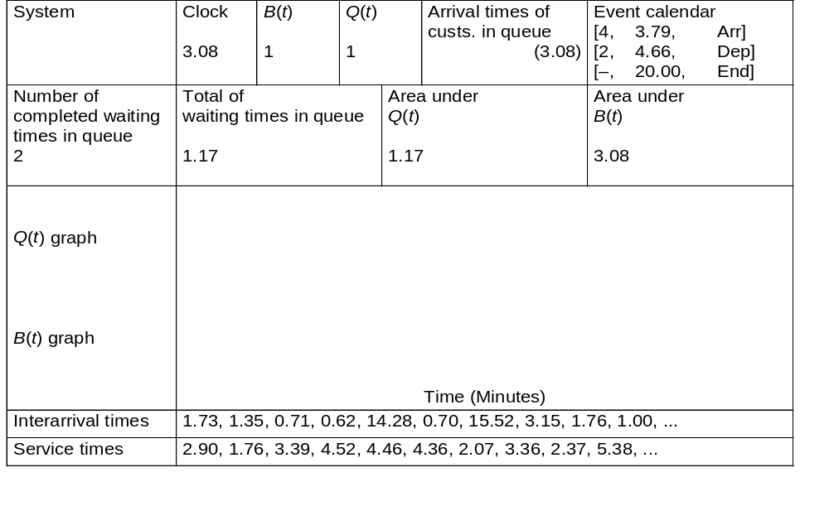
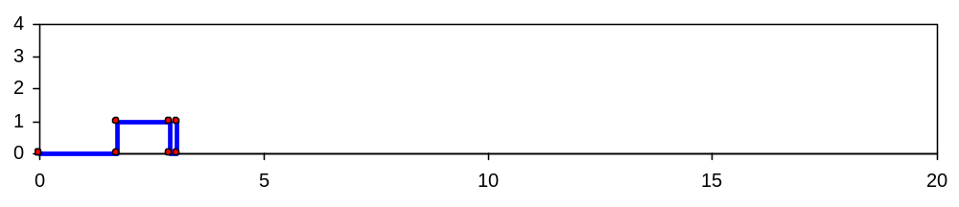
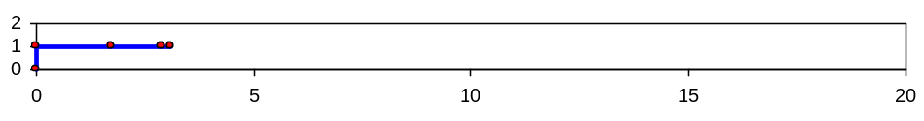
Simulation by Hand: t = 3.08, Arrival of Part 3
3
2
Simulation with Arena
Chapter 2 – Fundamental Simulation Concepts
Slide <number> of 46

Slide 30

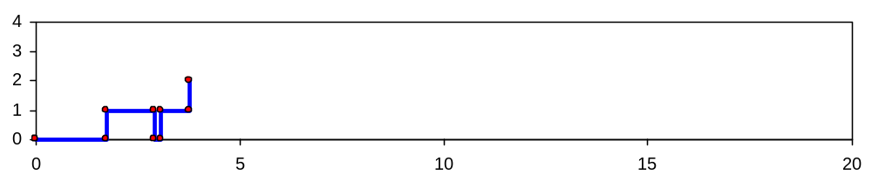
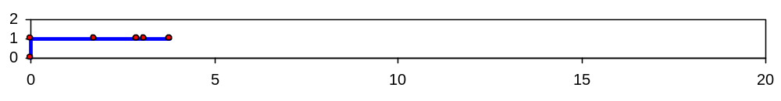
Simulation by Hand: t = 3.79, Arrival of Part 4
4
3
2
Simulation with Arena
Chapter 2 – Fundamental Simulation Concepts
Slide <number> of 46

Slide 31

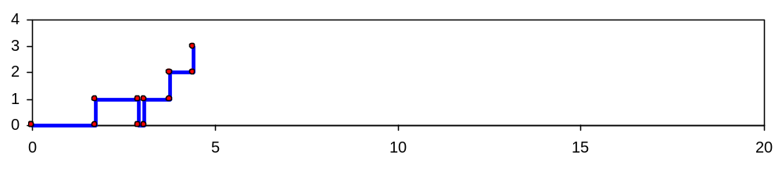
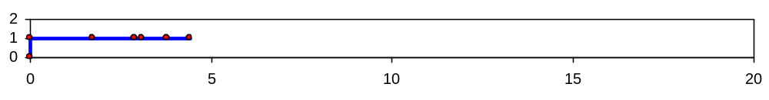
Simulation by Hand: t = 4.41, Arrival of Part 5
5
4
3
2
Simulation with Arena
Chapter 2 – Fundamental Simulation Concepts
Slide <number> of 46

Slide 32
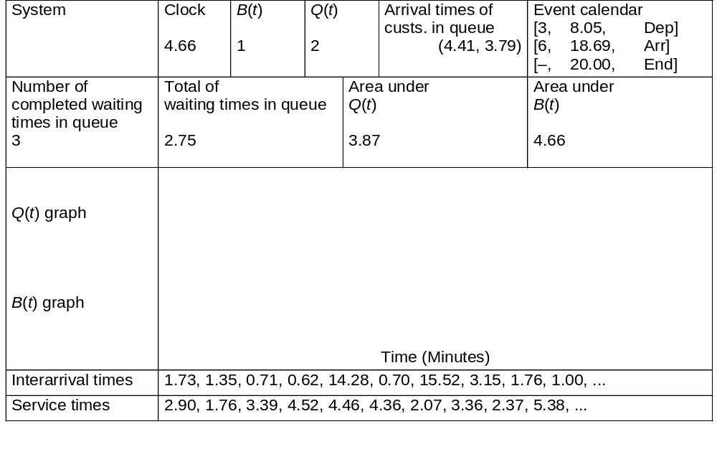
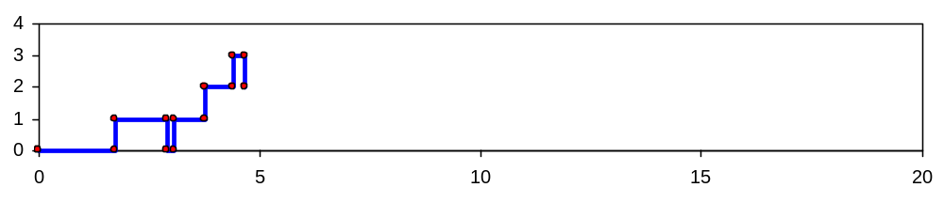
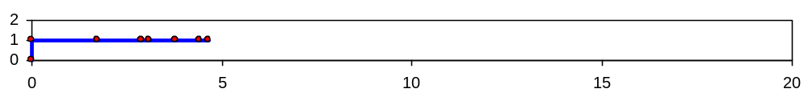
Simulation by Hand: t = 4.66, Departure of Part 2
5
4
3
Simulation with Arena
Chapter 2 – Fundamental Simulation Concepts
Slide <number> of 46

Slide 33
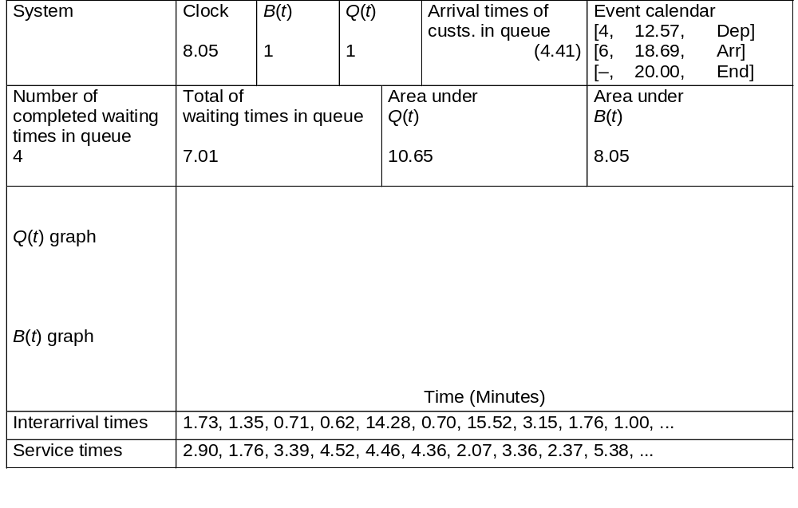
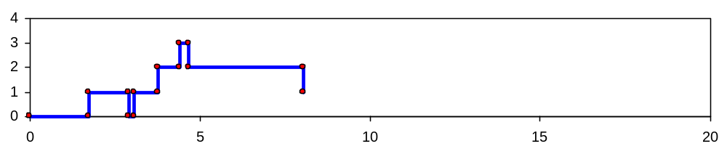
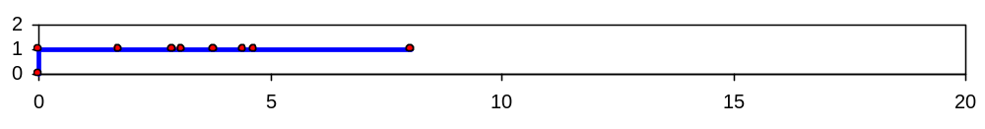
Simulation by Hand: t = 8.05, Departure of Part 3
5
4
Simulation with Arena
Chapter 2 – Fundamental Simulation Concepts
Slide <number> of 46

Slide 34
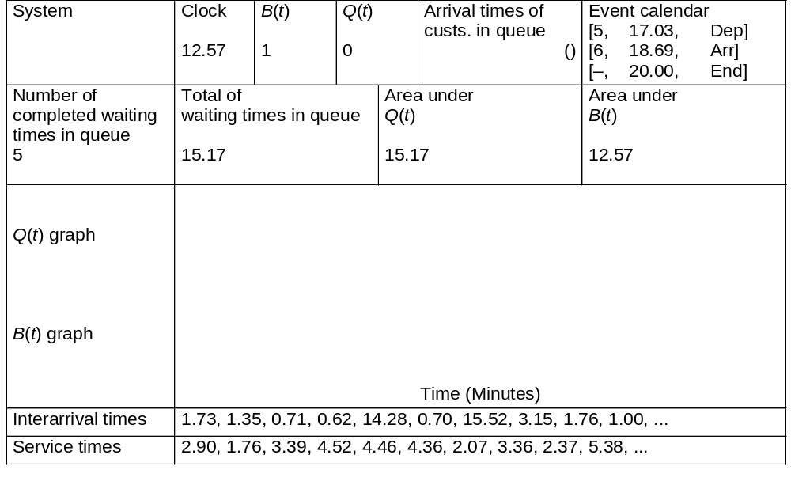
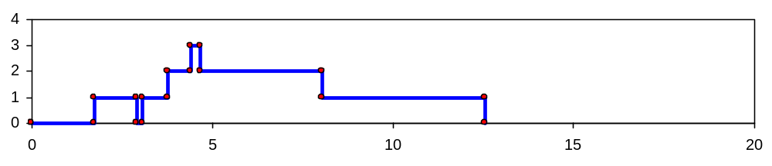
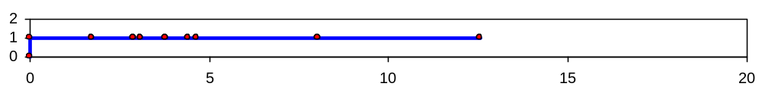
Simulation by Hand: t = 12.57, Departure of Part 4
5
Simulation with Arena
Chapter 2 – Fundamental Simulation Concepts
Slide <number> of 46

Slide 35
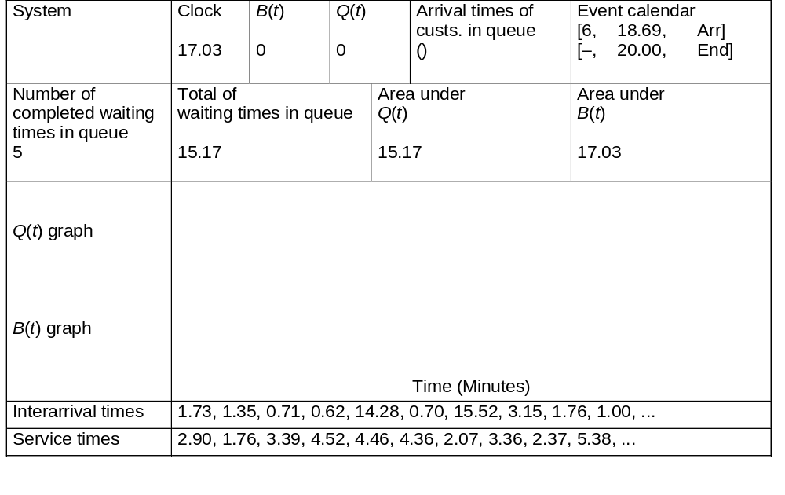
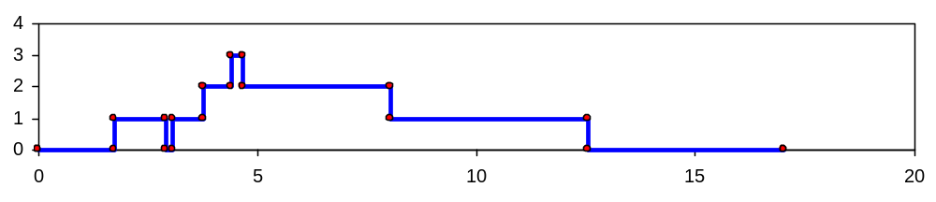
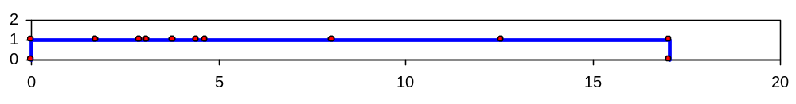
Simulation by Hand: t = 17.03, Departure of Part 5
Simulation with Arena
Chapter 2 – Fundamental Simulation Concepts
Slide <number> of 46

Slide 36

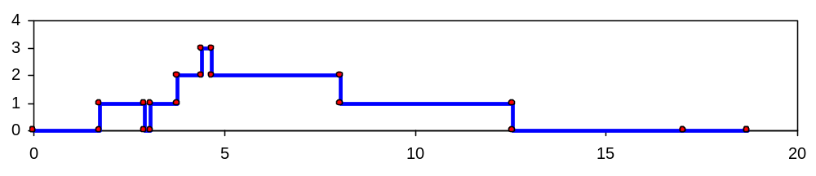
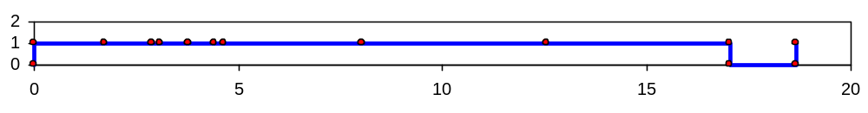
Simulation by Hand: t = 18.69, Arrival of Part 6
6
Simulation with Arena
Chapter 2 – Fundamental Simulation Concepts
Slide <number> of 46

Slide 37
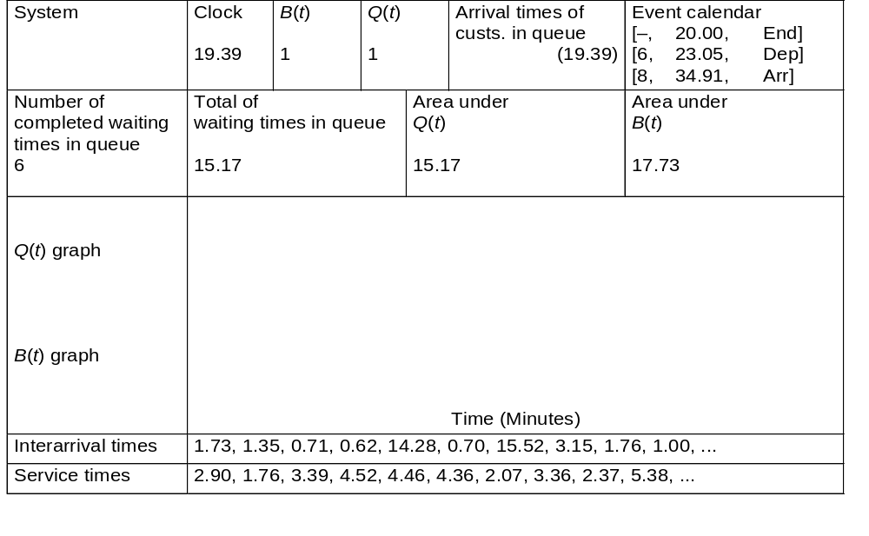
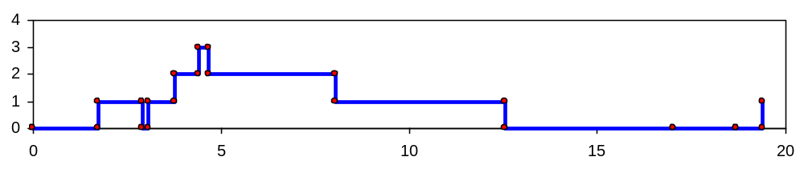
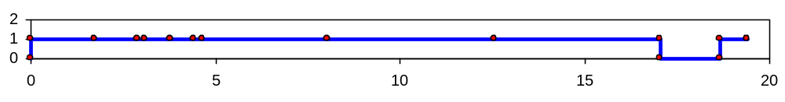
Simulation by Hand: t = 19.39, Arrival of Part 7
7
6
Simulation with Arena
Chapter 2 – Fundamental Simulation Concepts
Slide <number> of 46

Slide 38
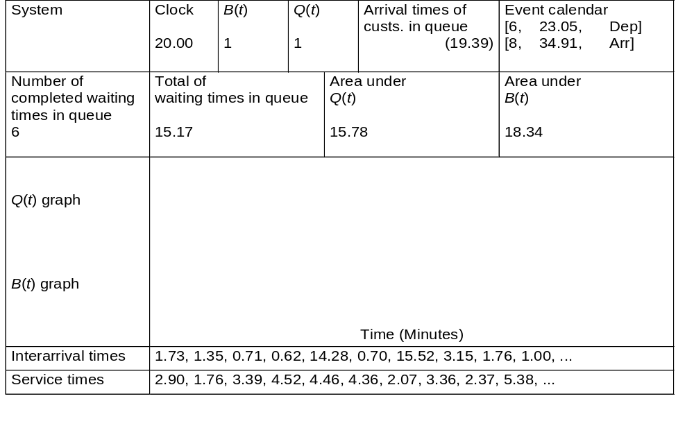
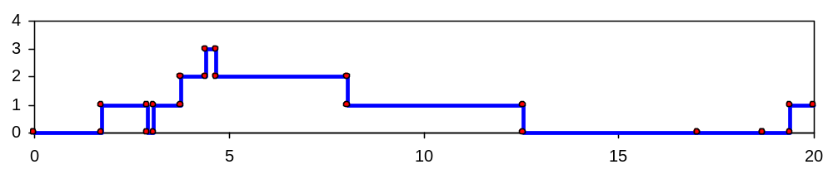
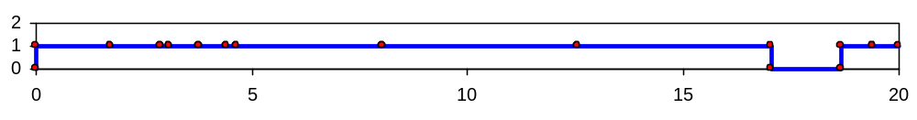
Simulation by Hand: t = 20.00, The End
7
6
Simulation with Arena
Chapter 2 – Fundamental Simulation Concepts
Slide <number> of 46

Slide 39
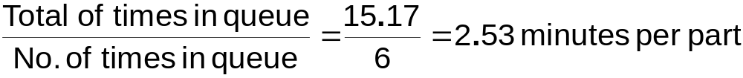
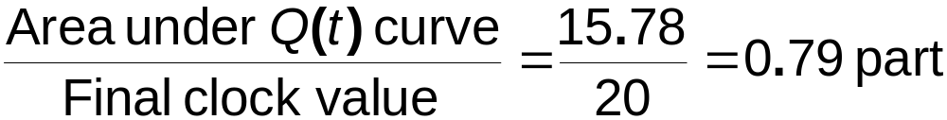
Simulation by Hand:
Finishing Up
Average waiting time in queue:
Time-average number in queue:
Utilization of drill press:
Simulation with Arena
Chapter 2 – Fundamental Simulation Concepts
Slide <number> of 46

Slide 40

Complete Record of the Hand Simulation
Simulation with Arena
Chapter 2 – Fundamental Simulation Concepts
Slide <number> of 46

Slide 41
Event-Scheduling Logic via Programming
Clearly well suited to standard programming
Often use “utility” libraries for:
  List processing
  Random-number generation
  Random-variate generation
  Statistics collection
  Event-list and clock management
  Summary and output
Main program ties it together, executes events in order
Simulation with Arena
Chapter 2 – Fundamental Simulation Concepts
Slide <number> of 46

Slide 42
Simulation Dynamics: The Process-Interaction World View
Identify characteristic entities in the system
Multiple copies of entities co-exist, interact, compete
“Code” is non-procedural
Tell a “story” about what happens to a “typical” entity
May have many types of entities, “fake” entities for things like machine breakdowns
Usually requires special simulation software
  Underneath, still executed as event-scheduling
The view normally taken by Arena
Simulation with Arena
Chapter 2 – Fundamental Simulation Concepts
Slide <number> of 46

Slide 43




Randomness in Simulation
The above was just one “replication” — a sample of size one (not worth much)
Made a total of five replications:
Confidence intervals for expected values:
  In general,
  For expected total production,
Note
substantial
variability
across
replications
Simulation with Arena
Chapter 2 – Fundamental Simulation Concepts
Slide <number> of 46

Slide 44
Comparing Alternatives
Usually, simulation is used for more than just a single model “configuration”
Often want to compare alternatives, select or search for the best (via some criterion)
Simple processing system: What would happen if the arrival rate were to double?
  Cut interarrival times in half
  Rerun the model for double-time arrivals
  Make five replications
Simulation with Arena
Chapter 2 – Fundamental Simulation Concepts
Slide <number> of 46

Slide 45

Results: Original vs. Double-Time Arrivals
Original – circles
Double-time – triangles
Replication 1 – filled in
Replications 2-5 – hollow
Note variability
Danger of making decisions based on one (first) replication
Hard to see if there are really differences
Need: Statistical analysis of simulation output data
Simulation with Arena
Chapter 2 – Fundamental Simulation Concepts
Slide <number> of 46

Slide 46
Overview of a Simulation Study
Understand the system
Be clear about the goals
Formulate the model representation
Translate into modeling software
Verify “program”
Validate model
Design experiments
Make runs
Analyze, get insight, document results
Simulation with Arena
Chapter 2 – Fundamental Simulation Concepts
Slide <number> of 46

